Slide 1
How I Learned to Love Classical Studies:
Information Behavior Studies and Digital Humanities
Dr. June Abbas
School of Library and Information Studies
University of Oklahoma
Presented to Digital Humanities @ OU Day III
September 9, 2016

Slide 2
Partners
The Andrew W. Mellon Foundation
Society for Classical Studies
Medieval Academy of America
Renaissance Society of America
The University of Oklahoma
University of Oklahoma Libraries

Slide 3
Mission
To facilitate the finding and, where openly available and accessible online, the reading of all texts written in Latin
To publish and curate critical editions of Latin texts, of all types, from all eras, and to facilitate an ongoing scholarly conversation about these texts through open collaboration and annotation

Slide 4
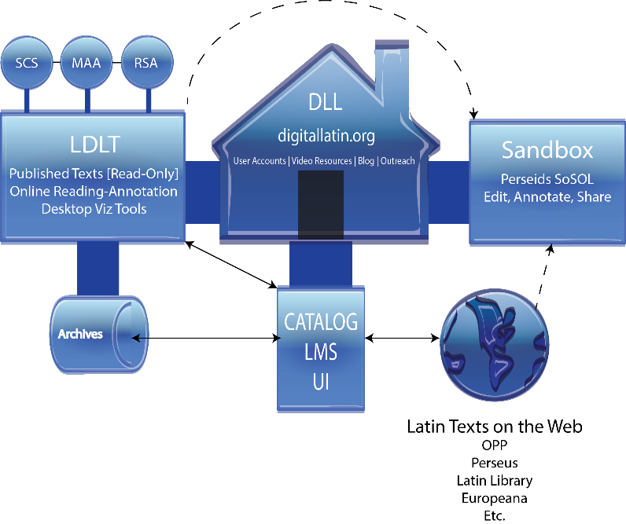

Slide 5
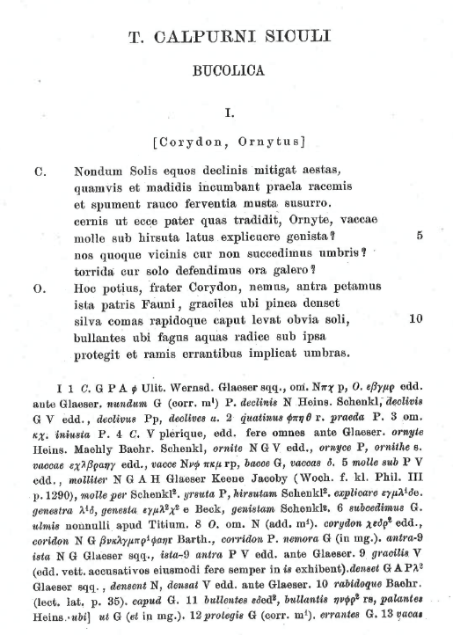

Slide 6
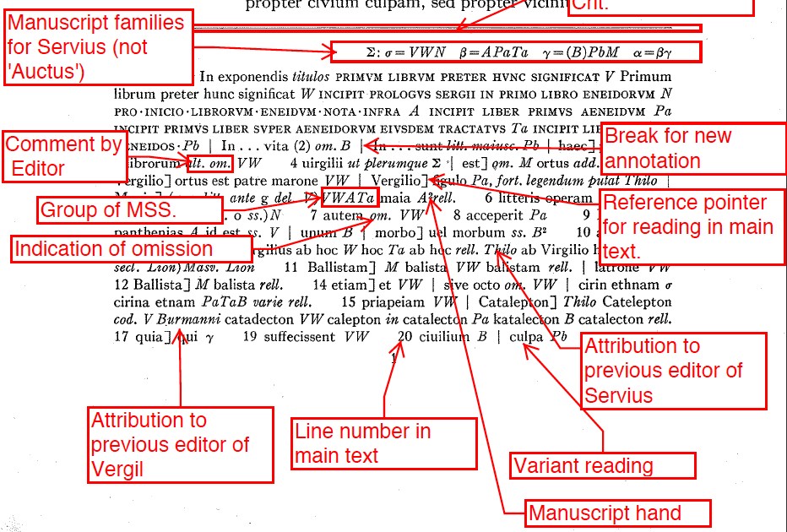

Slide 7
Tools or Methods Enabling the Digital Nature of the Project
Drupal CMS
Custom metadata harvesting module
Custom entity linking module
TEI XML
Data visualization and analysis
Improvise
Desktop tools built by CS GRAs

Slide 8
Information behavior
Provide researchers, system designers with a picture of the user group(s)’ behaviors, information needs, tasks, interactions, and processes while using systems and other resources to satisfy information needs or to develop new knowledge. Usually to accomplish a specific set of tasks or activities.
Can be part of user-centered design process
Inform development of interfaces, underlying data model for system architecture, metadata schema, interface design to support user tasks.

Slide 9
IB Study in DLL
The IB study for the DLL was designed with specific goals in mind:
Gain a greater understanding about the information behavior of the 3 user groups (Latin scholars, graduate students, and high school teachers who teach Latin)
Determine the work process of scholars who edit a critical edition or create a commentary
Determine how the three user groups use critical editions/apparatus in their scholarship, teaching, and other activities
Outline the print and digital resources used by the three user groups,
the reasons for use
Issues encountered when using resources
Features liked/disliked/essential
Elicit ideas for DLL catalog design, LDLT and DLL features and desired functionality of difference systems within the DLL

Slide 10
Method
Three methods used in the study
In depth interviews with user groups
Task demonstration of their use of digital and print resources
Task Diary kept for 2-3 weeks of scholarly activities and resource use
Sample
16 total participants: 10 scholars, 3 PhD students, and 3 high school teachers
Sample is a purposive sample determined by Dr. Huskey but then email invitations sent to participants.
Sample includes scholars and PhD students from US and abroad and high school teachers from OKC Metro area
Interviews conducted Oct. 2014-Jan. 2015 at 3 universities in the US

Slide 11
Data analysis

Slide 12
Outcomes
Use of digital tools by three user groups
Information seeking behaviors/work (task) analysis
Searching strategies
Resources used
What is necessary in metadata in library catalog?
Usability of digital tools
What issues do they encounter when using library catalogs and other digital tools?
Features analysis
What aspects of digital tools they use are useful/not useful/frustrating
What is missing from digital tools they use that we should include in the components of the DLL?

Slide 13
Outcomes cont.
Changes to Critical apparatus/critical edition
Features in Reading Room/Sandbox
Features encoded in the digital critical edition/apparatus
Content
Features/Additions
Functionality/Display/Navigation
Process of developing critical edition/apparatus
Decisions of editors while developing CE

Slide 14
Task | Resources Used | DLL Component | Supports in DLL
Choose Author/Work | Library Catalogs Online Databases Personal Collections Personal Network | DLL Catalog | Metadata in DLL catalog to support choice Author and Work records showing all previous editions of Work Author and Work records showing all manuscripts of Work Bibliographies of commentaries, articles, etc.
Locate manuscripts and editions | Library Catalogs Online Databases/Websites/ Repositories Personal collections Personal Network | DLL Catalog | Metadata in DLL catalog to support choice Author and Work records showing all previous editions of Work Author and Work records showing all manuscripts of Work Bibliographies of commentaries, articles, etc.
Collation | Manuscripts Previous editions Commentaries Scholarly Articles | LDLT editions Visualization Tools Research Tools | Published digital critical editions Review variants across manuscripts Morphological analysis tools, dictionary, Plesaides
Review/prune collation table | Collation table Manuscripts, Editions, etc. | LDLT editions Visualization Tools Research Tools | Published digital critical editions Review variants across manuscripts Morphological analysis tools, dictionary, Plesaides

Slide 15
Develop the Stemma | Collation table Manuscripts, Editions, etc. | LDLT editions Visualization Tools Research Tools | Published digital critical editions Review variants across manuscripts Morphological analysis tools, dictionary, Plesaides
Move from Archetypal text (Point A) to original (Point B) | Manuscripts Previous editions Commentaries Scholarly Articles | LDLT editions Visualization Tools Research Tools | Published digital critical editions Review variants across manuscripts Morphological analysis tools, dictionary, Plesaides
Reconstruct Text to use in critical edition | Collation table Manuscripts, editions, etc. | LDLT editions | Published digital critical editions
Synthesize/Put together the Critical Apparatus | Collation table Manuscripts, editions, etc. | LDLT editions | Published digital critical editions
Refining the Text and Critical Apparatus | Critical Apparatus Collation table | Research Tools | Morphological analysis tools, dictionary, Plesaides
Develop Preface and Conspectus | Manuscripts, editions, etc.
Compile Introduction | All sources used by Editor but mostly editor’s judgement | LDLT editions | Published digital critical editions

Slide 16
Outcomes cont.
Catalog record changes
Include the elements already in library catalogs
More in depth date/time period metadata
Provenance
More in depth info about the manuscript (i.e. illuminator, scribe, status)
Name of all works in an anthology
Links to related bibliographies
Audience level
Educational standards
Links to all available editions and commentaries (in and out of copyright)
Classification of author by type of work (epic poet)

Slide 17
DLL Works Content Type Model
Library catalog (MARC) element | Dublin Core element
URI | identifier
Author (link to authority record-URI) | creator
Other contributors (e.g. scribes, illuminator) | contributors
Title | Title; hasPart (talk to Sam more)
Date (can be original date of MS or publication) | date; dateSubmitted
Publisher (if applicable) | publisher
Format | format; medium?
Physical description | description; extent
Note (perhaps Location/Provenance note if MS, status note, colophon, transmission history, etc.) | coverage; source; provenance; description; abstract
Language | language
Copyright statement | rights; rightsholder; license;accessRights
*Subject (most users did not use this element) *Genre (part of Subject but in this case can be used as Literary form) | subject; type
Link to external Manuscript item record(s) (repeatable) | relation; isVersionOf
Link to digital copy(ies) of Manuscript (if available) | relation; isFormatOf; hasFormat
Link to internal/external Edition(s) item record(s) (repeatable)??? | relation; isVersionOf; hasVersion
Link to LDLT edition (if available) | relation; isVersionOf; hasVersion
*Link to DLL Bibliography | relation

Slide 18
Digital Latin Library
Social media campaign underway
Informational site launched in June/July 2015
User behavior studies completed
Prototyping of visualization tools in progress
CMS infrastructure in development
Custom Drupal modules developed, now in testing
Prototyping of DLL Catalog in July/October 2016
Beta of DLL Catalog in Fall 2016

Slide 19
Contact us at:
June Abbas, Co-PI (user study and DLL Catalog) jmabbas@ou.edu
Sam Huskey, PI (anything related to Latin stuff, encoding of digital critical apparatus, project vision, overview, etc.) huskey@ou.edu
Chris Weaver, Co-PI (visualization tools) weaver@cs.ou.edu

